Slide 1
Relational Databases

Slide 2
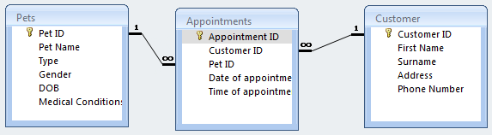
Relational Databases
Have multiple tables which are linked together by key fields. A field which links to another table is called a foreign key.
As data is only ever stored once, it is never repeated. This saves time and storage space. It is also easier to update (change, delete, insert a record)

Slide 3
Add the following appointments to the relevant table
Nina Verlaques is bringing in Danny, her Giant Tortoise. She would like an appointment on 1st May at 9:00
Alicia Davis is bringing in Dorry, her dog. She needs an appointment for this Thursday afternoon
Andrea DC Lablache’s pet cat has damaged his leg. Please make an appointment for Elvis this Friday.

Slide 4
Create a new report
It should show only the records for appointments for this week
Should fit to A4 landscape
Not cut off any fields or labels
Shows only the following fields: Appointment Date, Appointment Time, Customer First Name, Surname, Phone Number, Pet Name, Pet Condition,
Sort the report by appointment date and then appointment time.
Add a group by date
HINT: You will need to use all tables.

Slide 5
Extension
It should show only the records for all dogs which were born before 2012
Should fit to A4 portrait
Not cut off any fields or labels
Shows only the following fields: Pet ID, Pet Name, Pet Condition,
Sort the report by Pet Name
Count the number of pets at the bottom of the report

