Slide 1
Paris Charles de Gaulle airport.

Slide 2
Which airlines it serves.
Air Canada, Air India, Air Transat, American airlines, Asiana Airlines, British Airways, Brussels Airlines, KLM, Delta Airlines, Japan Airlines.

Slide 3
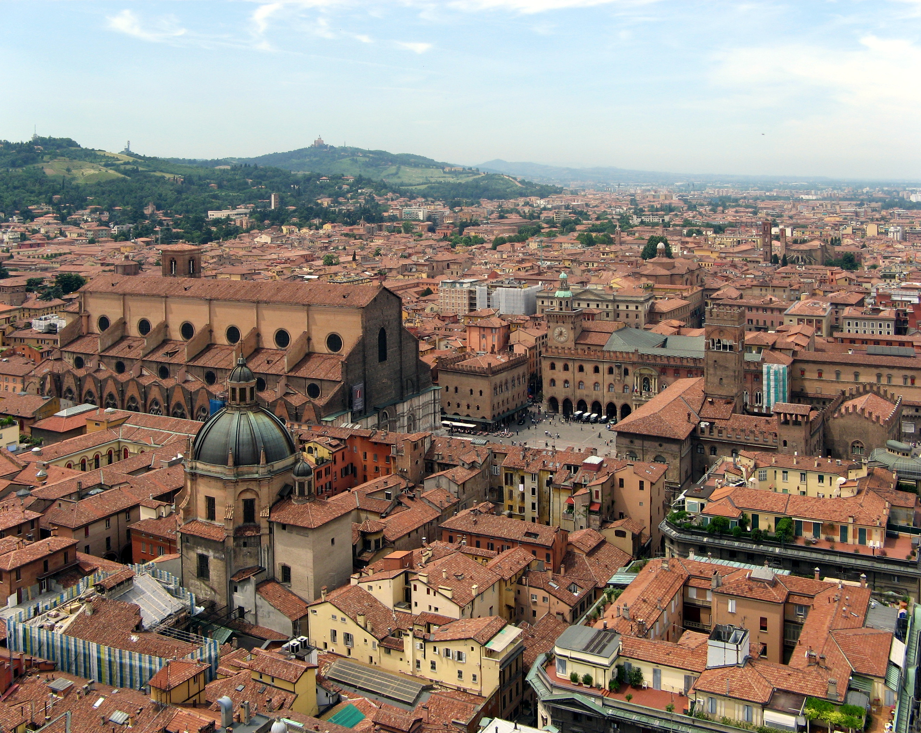
To which destinations passengers can travel?
Scotland
Germany
Amsterdam
Hungary
Zurich
Prague
Poland
Atlanta, New York
Italy: Venice, Bologna, Rome, Milan
Switzerland: Geneva

Slide 4
What products the airport offers.
luxury fashion accessories, exclusive beauty products, high-end French wines, whisky and cognac.

Slide 5
What services the airport offer
Shops: 121
Restaurants, bars, cafes: 62
Walk from shops to gates: Up to 30 minutes depending on terminal.
Interesting shops: Pure And Rare, Beauty Unlimited, La Cave a Cigares, Hermes, Long champ.

Slide 6
How can passegers can get to and from the airport
Rail connections from Gare du Nord

