Slide 1
What shape is the Earth?
Our learning aims today…
How do we know what shape the Earth is?
What evidence can we find?
How do we know whether or not the Earth is flat?

Slide 3
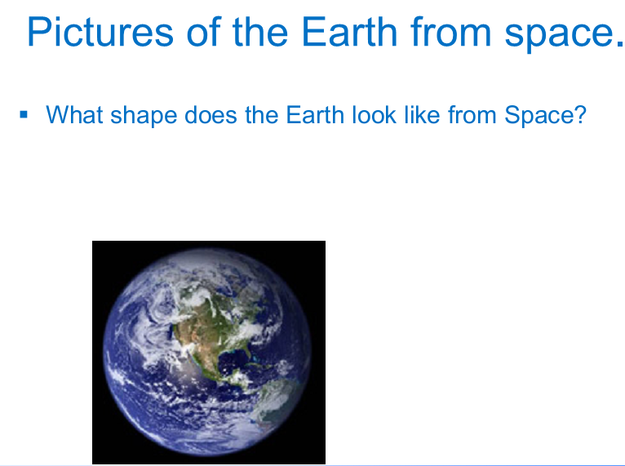
etinne

Slide 6
Christian, brigitte, amanda, mateo

Slide 8
Curve of the earth – chloe & mandy

Slide 11
Julius &b gerad paul, sabastiano

